Slide 1
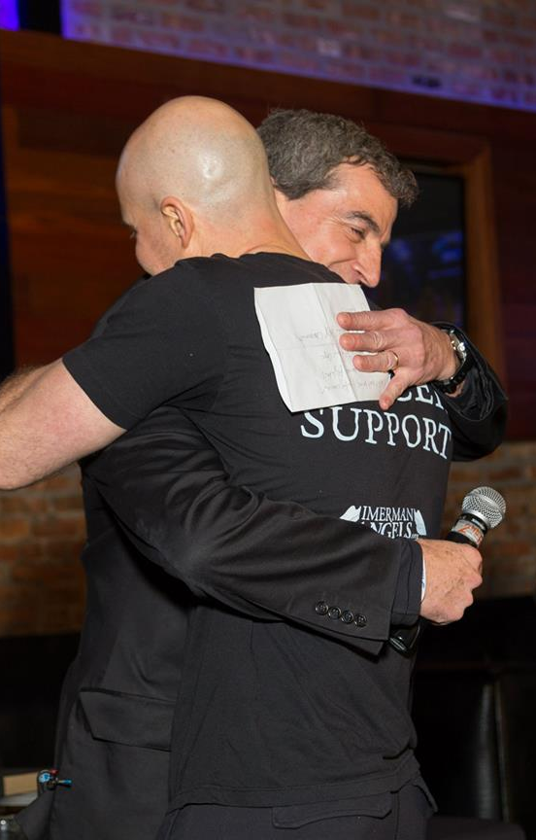
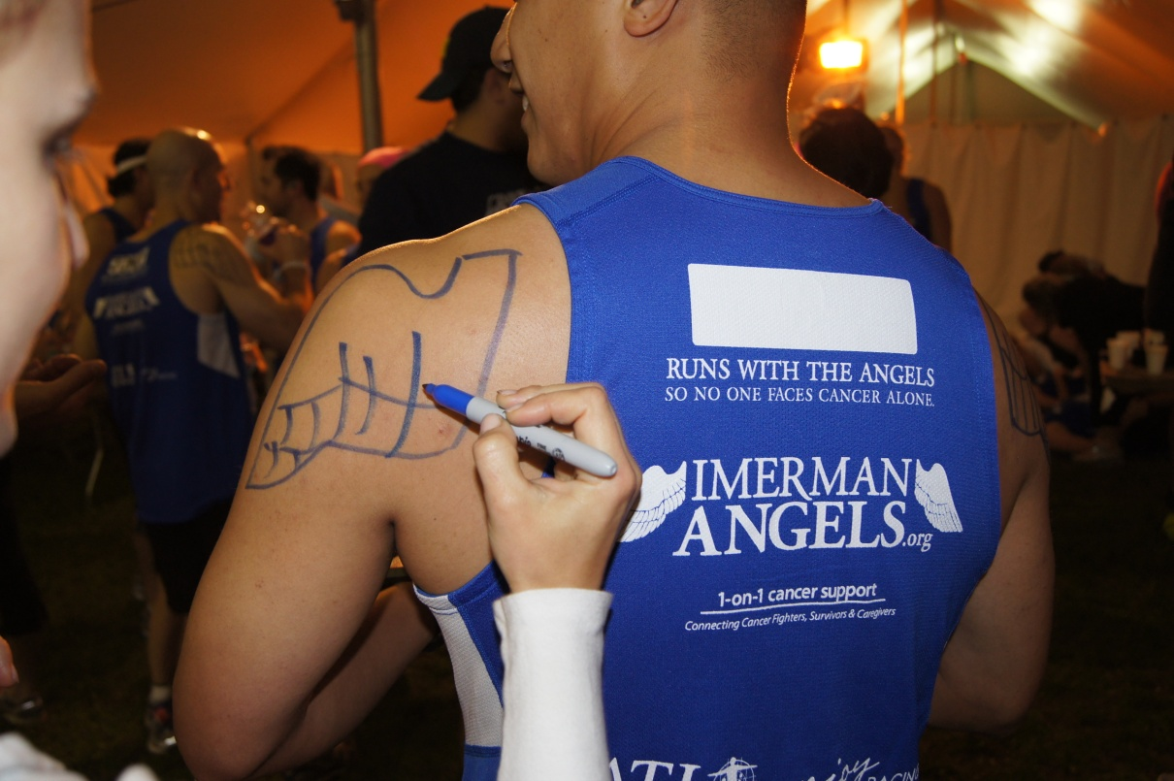
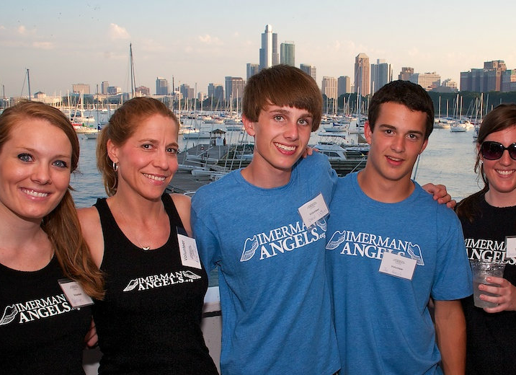
Notes:
Introduction (or re-introduction) of Imerman Angels and Mission Statement

Slide 2
How We
CONNECT
Conferences/Fairs
Team Imerman Angels
Doctors & Social Workers
Word of Mouth & Social Media
Sweet Treat Socials

Slide 3
Sweet Success
Create a warm, welcoming environment that provides an overall more pleasant hospital visit and allows people to experience the significance of one-on-one connections.
1
2
Raise awareness about Imerman Angels and the invaluable services we can provide.
3
Sign Up Patients and Caregivers to be matched with a “Mentor Angel” or become one themselves.

Slide 4
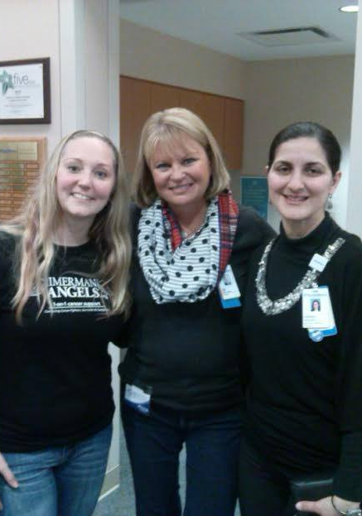
ALL ABOUT
You
Imerman Angels handles all event logistics for FREE. Participating patients and caregivers walk away with the feeling that YOU provided this uniquely beneficial experience.

Slide 5
How to Host an
Imerman Angels
Sweet Treat Social
3 SIMPLE STEPS
Step 1
Step 2
Step 3
Say “YES”!
Set A Date To Host
Watch Lives Change From Imerman Angels Connections

Slide 6
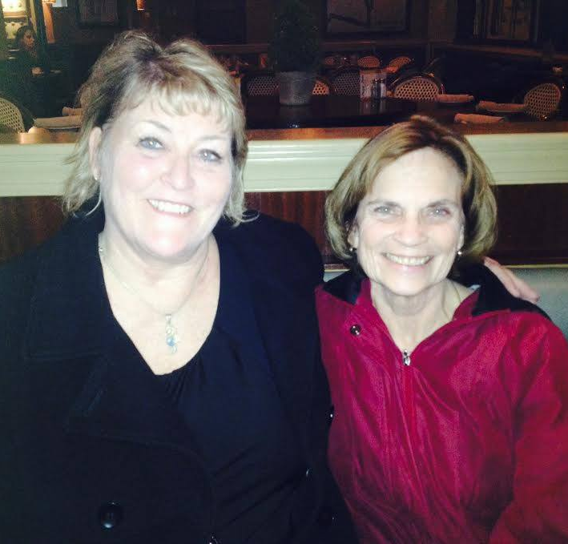
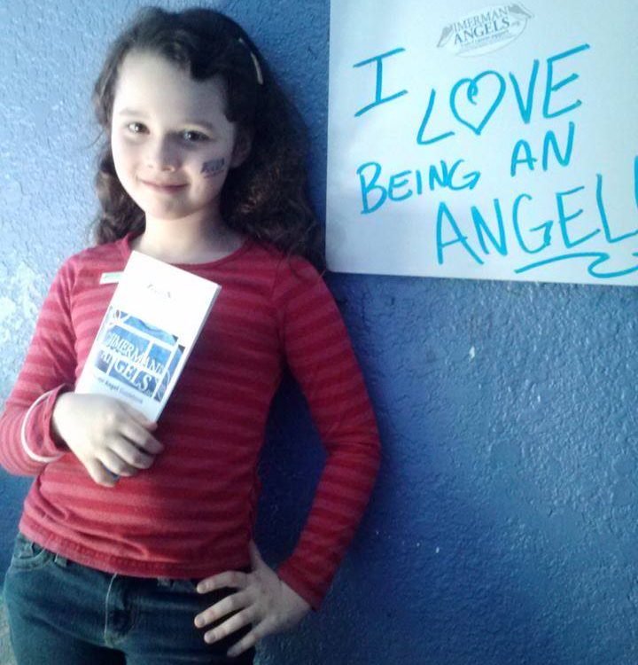
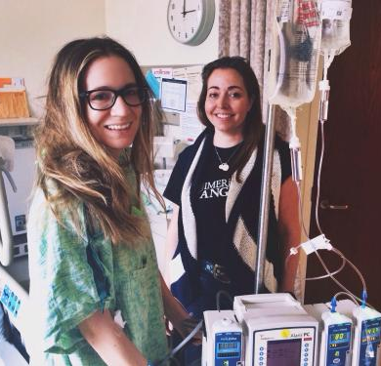
Angel
The Power
Of An

Slide 7
“Because support means LOVE and HOPE, when you listen they feel the Love. They appreciate the time that you spend with them.”
-Kurt Hulsebus, Caregiver Mentor Angel & STS Volunteer
“Our collaboration with Imerman Angels has not only benefited the patients of NorthShore Kellogg Cancer Center, but also the medical and support staff. Imerman Angels has partnered with us to provide educational events, which has resulted in patients and staff finding a mentor or volunteering to be a mentee. Imerman Angels helps us fulfill our vision for patient-centered and personalized care – providing treatment and support tailored for each individuals ‘specific needs’.”
- Tyler Bauer, Vice President of NorthShore University Health Systems
“I am so grateful to be part of the Sweet Treat Social. It is a wonderful way to educate, bring hope, and build friendships among our community.”
– Donna Andrews, Mentor Angel & STS Volunteer

Slide 8
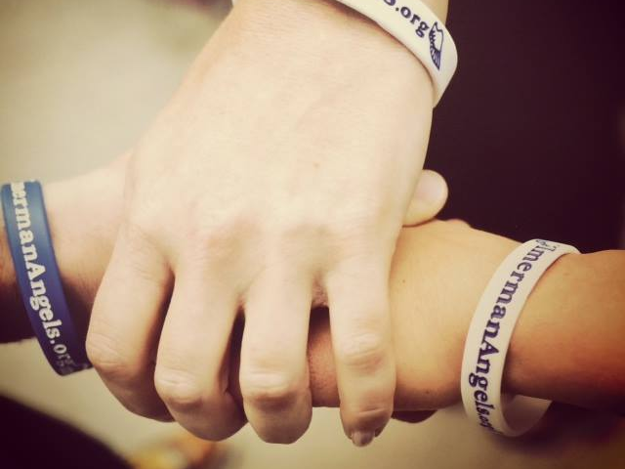
Imerman Angels would be honored to partner with Lurie’s Comprehensive Cancer Center
Notes:
Conclude Pitch Deck. Wrap up with questions and perhaps make another appointment to discuss next steps and timing of possibly starting Sweet Treat Socials at the hospital.

