Slide 1
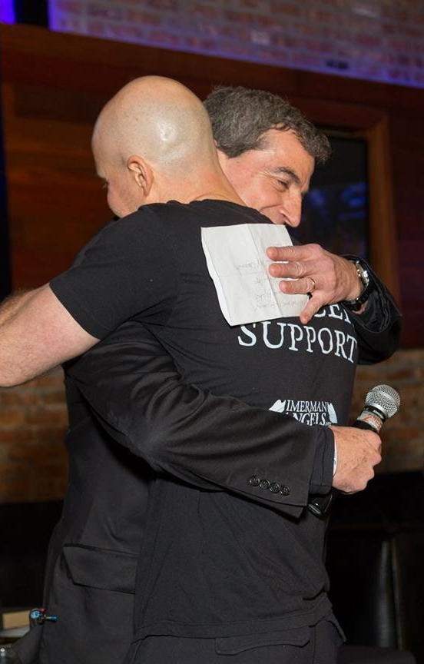
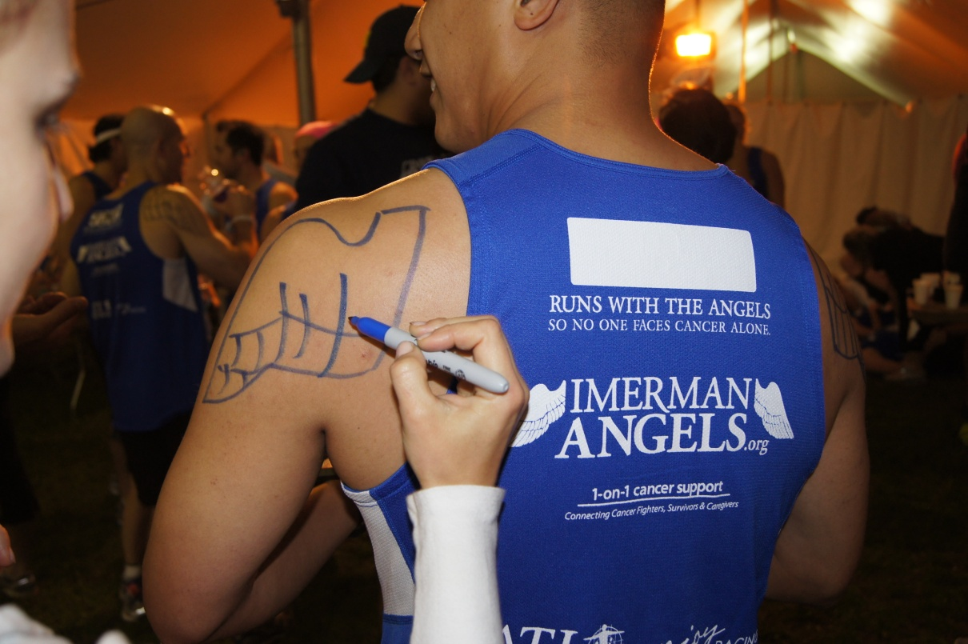
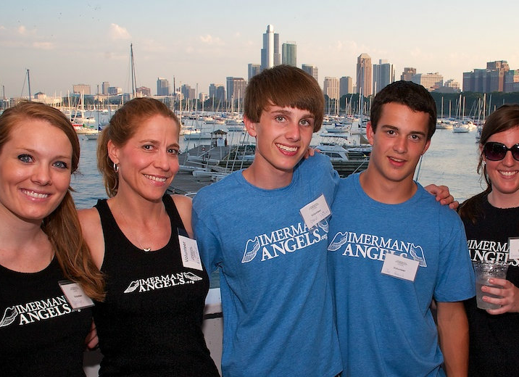
Notes:
Introduction (or re-introduction) of Imerman Angels and Mission Statement

Slide 2
How We
CONNECT
Conferences/Fairs
Team Imerman Angels
Doctors & Social Workers
Word of Mouth & Social Media
IA Socials

Slide 3
Sweet Success
1
Create a warm, welcoming environment that provides an overall more pleasant hospital visit and allows people to experience the significance of one-on-one connections.
2
Raise awareness about Imerman Angels FREE and invaluable service we can provide.
3
Sign Up Patients and Caregivers to be matched with a “Mentor Angel” or become one themselves.

Slide 4
Quick Note
These events are not about the number of registrations they result in—they are about spreading awareness!
Even if visitors don’t register, they will still think about IA or tell others, and they may even register another day

Slide 5
Reminders
Step 1
Step 2
Step 3
Professional Behavior
Parking
Validation
Imerman Angels Socials

Slide 6
Captain Objectives
1
Approach patients/caregivers and offer them food, drinks, brochures, etc. to bring them to the Social area while explaining the Imerman Angels mission.
2
Introduce guest to another guest, allowing them to make an IA-facilitated connection.
3
Leave visitors to explore the benefits of shared experiences and continue to recruit new guests from the lobby or other areas.

Slide 7
Protocol for Walk-in Volunteers
3 SIMPLE STEPS
Step 1
Step 2
Step 3
Fax all forms or send contact information to volunteering@imermanangels.org or enter online!
Let them shadow you
Volunteer Registration Form

Slide 8
The Logic Behind Lemonheads
1
Some people question why we give out lemonheads, as sugar is known to facilitate cancer growth. This is how to combat these criticisms!
2
Lemonheads do have sugar in them, but a few small pieces of candy will help to alleviate the metallic, appetite-killing taste that chemo gives patients.
3
Eating lemonheads is worth the slight sugar intake it entails because it allows chemo patients to revive their appetites and thus nourish themselves. The alternative can be starvation.

Slide 9
Hand out lemonheads with the BLUE side face-up! It ensure that the recipient will see our information.
More on Lemonheads

Slide 10
What do I do about donations?!
Step 1
Step 2
Step 3
Try not take any money—we are not there to raise funds.
If they insist, fill out a donation card. These will be provided.
Alternatively, refer them to the IA website to donate online.

Slide 11
What if something goes wrong?
Step 1
Step 2
Step 3
Try your best to address the problem yourself
If needed, locate hospital representative
Call Jackie!!!

Slide 12
Types of Visitors
Needy/talkers
Open/want emotional support
Want food but not talkative
Standoffish
Hurrying to treatments
Just want food to go
Already have a mentor
Caregivers
Caregivers who want to talk but not in front of their loved ones

Slide 13
Needy/Talkers
1
Introduce talkers to others already in the room
2
Have other volunteers recruit more visitors

Slide 14
Open/Want Support
1
Engage them, listen, and offer registration opportunity

Slide 15
Quiet
1
Strike up conversation and try to gauge whether they are hesitant or don’t want to talk
2
If any visitors have already been matched with a mentor angel, invite them to talk to the quieter ones and share their stories

Slide 16
Standoffish
1
Approach with an offering, emphasize FREE service
2
No pressure to register
3
Signage!!!

Slide 17
In a Rush
1
Give a brochure and tell them to come back later

Slide 18
Just Want Food
1
Try to give a brochure
2
If they want to take a lot of food, ask them to save some for others

Slide 19
Already Have A Mentor
1
Facilitate conversations between mentored and those who want emotional support or are quiet
2
Ask them to share their stories
3
Encourage them to become Mentor Angels→ “I’ll wait for you on the other side”

Slide 20
Caregivers
1
Make sure that they understand that we support them
2
Engage in conversation, make them feel important too—whole family is affected
3
They are still helpful, even if their loved one has passed

Slide 21
Caregivers that want support
1
If possible, take them to the group room (Evanston, Rush). Welcome them back while their loved one is in treatment or with doctors
2
Sidetrack patient with another volunteer or visitor
3
Ask them how they are doing—be prepared for reaction

Slide 22
Some Resources
Step 1
Step 2
Step 3
You may refer people to these partner organizations (please review)
Here are a few ways to introduce yourself at IA Socials!
Refer people to ← these organizations for specific concerns

Slide 23
Rush Socials
1
As you walk into the room, remember to come in slowly, quietly, and with a smile. Introduce yourself!
2
Check out the agenda here to familiarize yourself with the protocol!

Slide 24
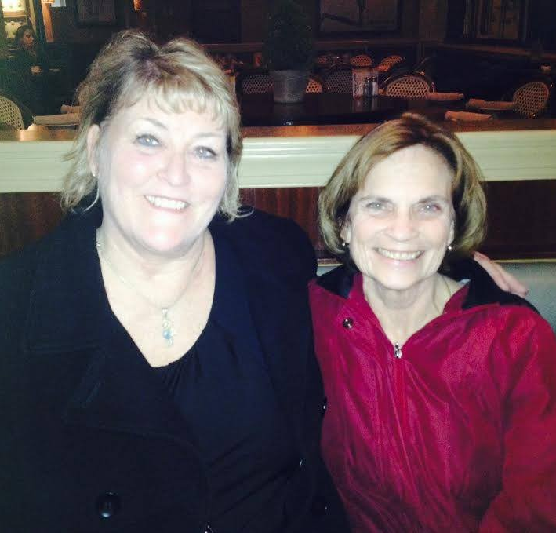
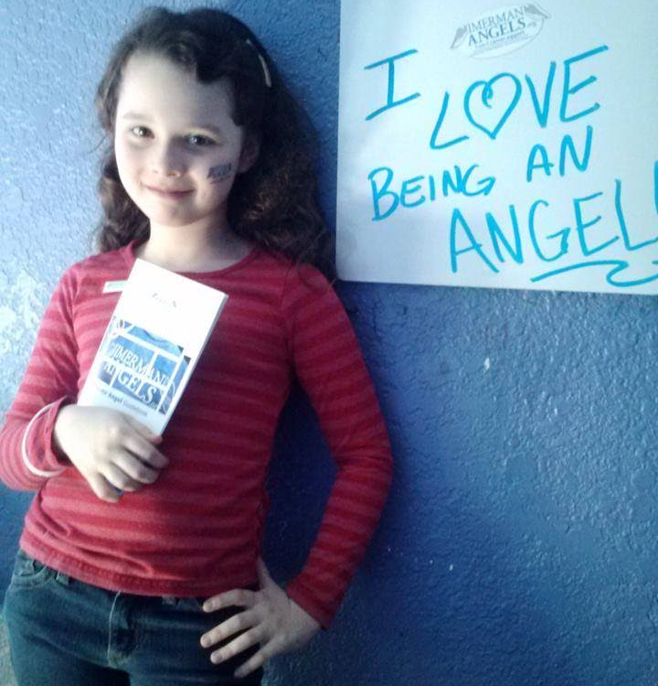
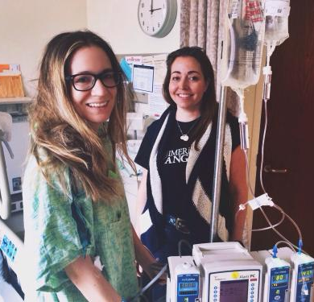
Angel
The Power
Of An

Slide 25
“Because support means LOVE and HOPE, when you listen they feel the Love. They appreciate the time that you spend with them.”
-Kurt Hulsebus, Caregiver Mentor Angel & STS Volunteer
“Our collaboration with Imerman Angels has not only benefited the patients of NorthShore Kellogg Cancer Center, but also the medical and support staff. Imerman Angels has partnered with us to provide educational events, which has resulted in patients and staff finding a mentor or volunteering to be a mentee. Imerman Angels helps us fulfill our vision for patient-centered and personalized care – providing treatment and support tailored for each individual’s ‘specific needs’.”
- Tyler Bauer, Vice President of NorthShore University Health Systems
“I am so grateful to be part of the Sweet Treat Social. It is a wonderful way to educate, bring hope, and build friendships among our community.”
– Donna Andrews, Mentor Angel & STS Volunteer

Slide 26
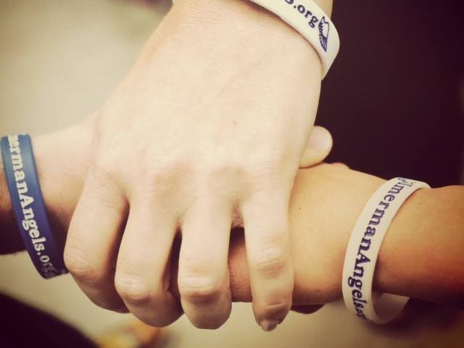
Imerman Angels is so honored to have you as a representative for us to help spread the word of our mission! Thank you so much for all you do!!!
Notes:
Conclude Pitch Deck. Wrap up with questions and perhaps make another appointment to discuss next steps and timing of possibly starting Sweet Treat Socials at the hospital.

